Slide 1

Advances of Machine Learning in Finance: OLS and LASSO regressions in R
Hadi Movaghari
2022-2023

Slide 2
Outline
Section 1: LASSO theory
Section 2: The packages
Section 3: Data
Section 4: OLS & LASSO regression in R
Advances of Machine Learning in Finance: OLS and LASSO regressions in R
University of Glasgow
2022-2023

Slide 3
Section 1: LASSO theory

Slide 4
LASSO regression
Least Absolute Shrinkage and Selection Operator (LASSO) is a method for variable selection in regression analysis
LASSO is developed by Tibshirani (1996), originally based on the idea in ridge regression of Hoerl and Kennard (1970)
The LASSO has created a broad class of variables election methods called: penalized variable selection
Advances of Machine Learning in Finance: OLS and LASSO regressions in R
University of Glasgow
2022-2023

Slide 5
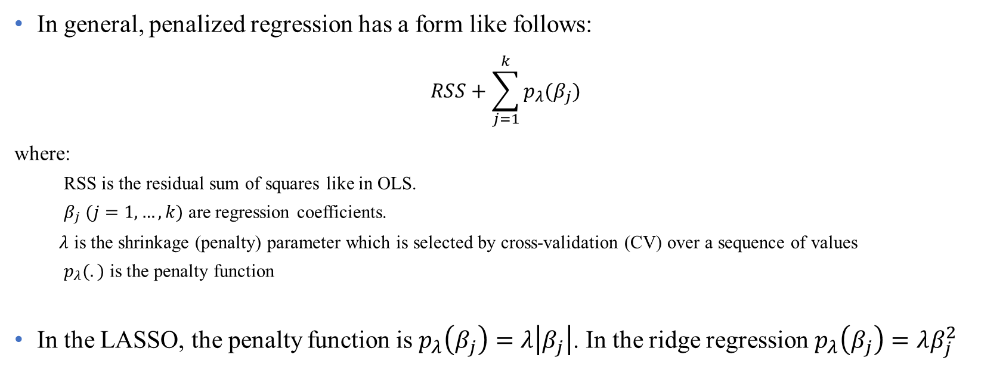
LASSO regression (Cont’d)
In general, penalized regression has a form like follows:
$$RSS+\sum_{j=1}^{k}{p_{λ}(β_{j})}$$
where:
RSS is the residual sum of squares like in OLS.
$β_{j} (j=1,…,k)$ are regression coefficients.
$λ$ is the shrinkage (penalty) parameter which is selected by cross-validation (CV) over a sequence of values
$p_{λ}(.)$ is the penalty function
In the LASSO, the penalty function is $p_{λ}\left(β_{j}\right)=λ\left|β_{j}\right|$. In the ridge regression $p_{λ}\left(β_{j}\right)=λβ_{j}^{2}$
Advances of Machine Learning in Finance: OLS and LASSO regressions in R
University of Glasgow
2022-2023

Slide 6
LASSO regression (Cont’d)
Generalizations of the LASSO
Bridge regression (Fu, 1998)
SCAD (Fan & Li, 2001)
Elastic Net (Zou & Hastie, 2005)
Fused LASSO (Tibshirani, et al., 2005)
Group LASSO (Yuan & Lin, 2006)
Adaptive LASSO (Zou, 2006)
For a complete review, see Hastie et al. (2015)
Advances of Machine Learning in Finance: OLS and LASSO regressions in R
University of Glasgow
2022-2023

Slide 7
Section 2: The packages

Slide 8
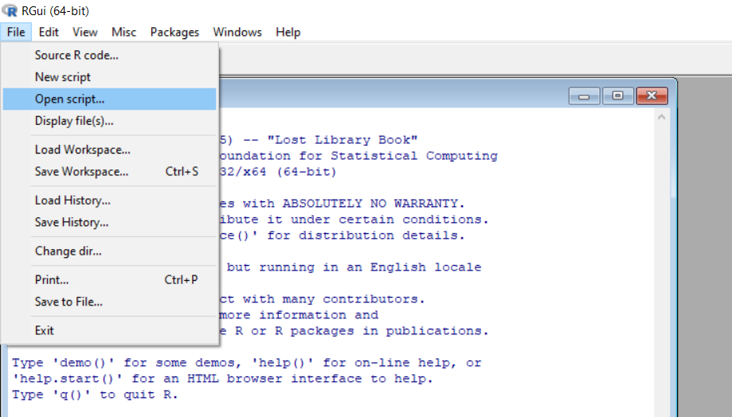
Open your script file!
Download files (script, data, PowerPoint) from Moodle or https://github.com/hadigilan/AdvMLFinance_LASSO.git
From File -> Open script find your file and then open
Advances of Machine Learning in Finance: OLS and LASSO regressions in R
University of Glasgow
2022-2023

Slide 9
R packages for LASSO
There are different R packages to conduct LASSO regression using different algorithm, like:
lassoshooting which utilize shooting algorithm of Fu (1998)
lars which utilizes least angle regression of Efron et al. (2004)
glmnet which utilizes cyclical coordinate descent algorithm of Friedman et al. (2010)
We use the package glmnet, perhaps the most powerful R package for LASSO regression
For detailed applications of glmnet, see James et al. (2017)
Advances of Machine Learning in Finance: OLS and LASSO regressions in R
University of Glasgow
2022-2023

Slide 10
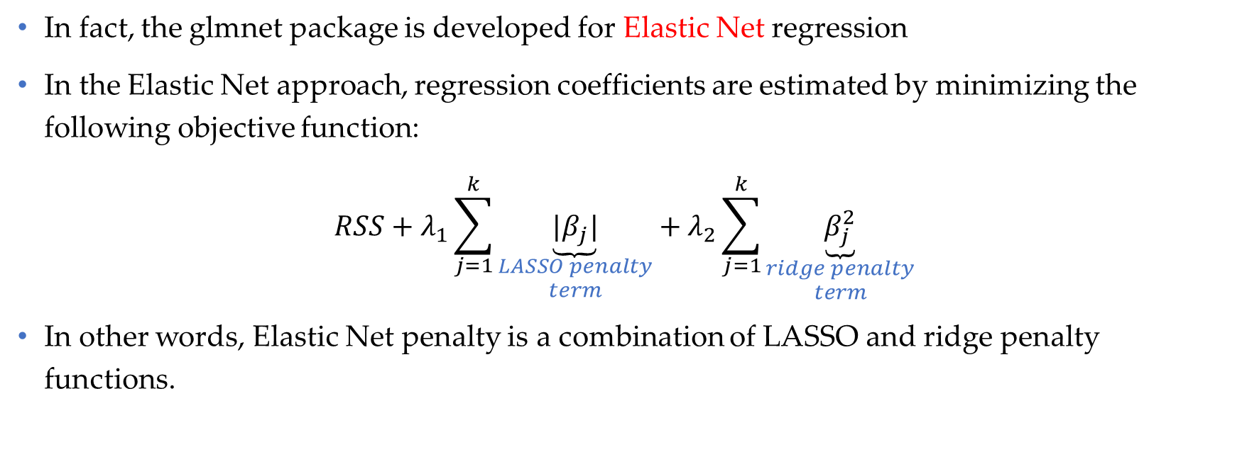
glmnet package
In fact, the glmnet package is developed for Elastic Net regression
In the Elastic Net approach, regression coefficients are estimated by minimizing the following objective function:
$$RSS+λ_{1}\sum_{j=1}^{k}{\underset{\begin{aligned}LASSO penalty \\ term\end{aligned}}{\underbrace{|β_{j}|}}}+λ_{2}\sum_{j=1}^{k}{\underset{\begin{aligned}ridge penalty \\ term\end{aligned}}{\underbrace{β_{j}^{2}}}}$$
In other words, Elastic Net penalty is a combination of LASSO and ridge penalty functions.
Advances of Machine Learning in Finance: OLS and LASSO regressions in R
University of Glasgow
2022-2023

Slide 11
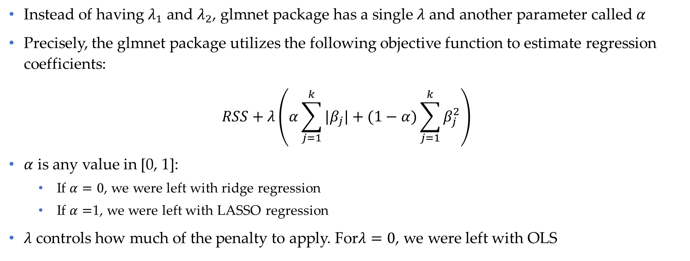
glmnet package (Cont’d)
Instead of having $λ_{1}$ and $λ_{2}$, glmnet package has a single $λ$ and another parameter called $α$
Precisely, the glmnet package utilizes the following objective function to estimate regression coefficients:
$$RSS+λ\left(α\sum_{j=1}^{k}{|β_{j}|}+(1−α)\sum_{j=1}^{k}{β_{j}^{2}}\right)$$
$α$ is any value in [0, 1]:
If $α=0$, we were left with ridge regression
If $α=$1, we were left with LASSO regression
$λ$ controls how much of the penalty to apply. For$λ=0$, we were left with OLS
Advances of Machine Learning in Finance: OLS and LASSO regressions in R
University of Glasgow
2022-2023

Slide 12
glmnet package (Cont’d)
The main functions in the glmnet package is glmnet and cv.glmnet with the following main arguments:
x
A matrix containing independent variables
y
A vector containing response variable
A value or a sequence of values for shrinkage parameter
lambda
Creates a trade-off between LASSO and ridge regression
alpha
Advances of Machine Learning in Finance: OLS and LASSO regressions in R
University of Glasgow
2022-2023

Slide 13
glmnet package (Cont’d)
To install the package and load it, run the following codes:
install.packages(“glmnet")
library(glmnet)
You can download the manual of the package from https://cran.r-project.org/web/packages/glmnet/glmnet.pdf
Advances of Machine Learning in Finance: OLS and LASSO regressions in R
University of Glasgow
2022-2023

Slide 14
Section 3: Data

Slide 15
The dataset
The dataset consists of 2,519 observations from US industrial firms in 2017.
Dependent variable is cash-to-asset ratio
There exist 12 explanatory variables including: firm size, market-to-book ratio, leverage, dividends, R&D, net working capital, capital expenditure, tangible assets, firm age, sales growth, cash flow, and cash flow volatility.
We use LASSO and OLS regression to predict cash ratio and compare their out-of-sample performance
Advances of Machine Learning in Finance: OLS and LASSO regressions in R
University of Glasgow
2022-2023

Slide 16
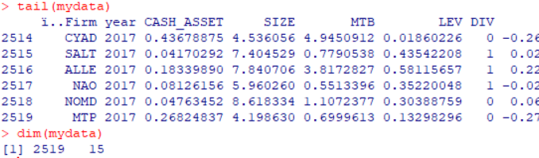
Importing data into R
mydata <- read.csv("C:/cash.csv")
head(mydata)
tail(mydata)
dim(mydata)
We assume that your data is in a csv file
read.csv is a function to read csv files.
Put the path of your file between “ “
Use \\ or / to separate paths.
head and tail are built-in functions to print the first and last rows of a data.frame, respectively.
dim is a function to see the dimensions of a data.frame
Advances of Machine Learning in Finance: OLS and LASSO regressions in R
University of Glasgow
2022-2023

Slide 17
Splitting data
For the purpose of comparison, we need to split the dataset into training and test sets.
The training set is used to fitting the model. The test set is used to prediction.
set.seed (1) is a built-in function to reproduce the results
sample is functions to draw random sample without replacement
nrow gives the number of rows of the dataset
train contains the indexes of observations from the training set
We are using 80% (20%) of data for fitting (predicting)
set.seed (1)
train <- sample (1: nrow(mydata), 0.8*nrow (mydata))
Advances of Machine Learning in Finance: OLS and LASSO regressions in R
University of Glasgow
2022-2023

Slide 18
Section 4: OLS & LASSO regression in R

Slide 19
OLS regression- fitting
As the starting point, we fit the OLS regression using training set:
lm is a built-in function to fit an OLS regression
summary is a generic function to get results of a fitted model
ols.lm<- lm( CASH_ASSET ~ SIZE + MTB + LEV + DIV + CFO + VOL + RD + LIQ + CAPEX + TANG + AGE + SG, data=mydata[train, ])
summary(ols.lm)
Advances of Machine Learning in Finance: OLS and LASSO regressions in R
University of Glasgow
2022-2023

Slide 20
OLS regression- predicting
Here, we predict using OLS regression based on the test data
predict is a built-in function to predict from a fitted model
newdata is the argument that introduces the test data
The second row computes the mean squared errors (MSE) for the OLS regression
pred.ols<- predict(ols.lm, newdata=mydata[ -train, ])
mean((mydata$CASH_ASSET[ -train ] - pred.ols )^2)
Advances of Machine Learning in Finance: OLS and LASSO regressions in R
University of Glasgow
2022-2023

Slide 21
LASSO regression- fitting
In contrast to lm function, we need to introduce independents as matrix and dependent variable as a vector to glmnet function
lam.grid is a sequence of 100 values for lambda. If it is not introduced by user, the function generates a sequence by default.
cv.glmnet selects the best lambda using cross-validation.
The selected lambda is saved in the lambda.min object
x<- as.matrix(mydata[,4:15])
y<- mydata$CASH_ASSET
lam.grid <- 10^ seq (10,-2, length =100)
set.seed(1)
lasso.glmnet<- cv.glmnet(x=x[train,], y=y[train], alpha=1, lambda=grid )
bestlam<- lasso.cv.glmnet$lambda.min
Advances of Machine Learning in Finance: OLS and LASSO regressions in R
University of Glasgow
2022-2023

Slide 22

LASSO regression- predicting
In contrast to lm function, the test data is introduced by newx
The argument s (i.e., size of the penalty) must be set to the selected lambda by CV in the previous step
The second row computes the mean squared errors (MSE) for the LASSO regression
pred.lasso<- predict(lasso.glmnet,
s=bestlam, newx =x[-train ,])
mean((y[ -train ] - pred.lasso)^2)
Advances of Machine Learning in Finance: OLS and LASSO regressions in R
University of Glasgow
2022-2023

Slide 23
References
Efron, B., Hastie, T., Johnstone, I., & Tibshirani, R. (2004). Least angle regression. The Annals of statistics, 32(2), 407-499.
Fan, J., & Li, R. (2001). Variable selection via nonconcave penalized likelihood and its oracle properties. Journal of the American statistical Association, 96(456), 1348-1360.
Friedman, J., Hastie, T., & Tibshirani, R. (2010). Regularization paths for generalized linear models via coordinate descent. Journal of statistical software, 33(1), 1.
Fu, W. J. (1998). Penalized regressions: the bridge versus the lasso. Journal of computational and graphical statistics, 7(3), 397-416.
Hastie, T., Tibshirani, R., & Wainwright, M. (2015). Statistical Learning with Sparsity: The Lasso and Generalizations. CRC Press.
Hoerl, A. E., & Kennard, R. W. (1970). Ridge regression: Biased estimation for nonorthogonal problems. Technometrics, 12(1), 55-67.
James, G., Witten, D., Hastie, T., & Tibshirani, R. (2017). An introduction to statistical learning with applications in R New York: springer.
Tibshirani, R. (1996). Regression shrinkage and selection via the lasso. Journal of the Royal Statistical Society: Series B (Methodological), 58(1), 267-288.
Tibshirani, R., Saunders, M., Rosset, S., Zhu, J., & Knight, K. (2005). Sparsity and smoothness via the fused lasso. Journal of the Royal Statistical Society: Series B (Statistical Methodology), 67(1), 91-108.
Yuan, M., & Lin, Y. (2006). Model selection and estimation in regression with grouped variables. Journal of the Royal Statistical Society: Series B (Statistical Methodology), 68(1), 49-67.
Zou, H. (2006). The adaptive lasso and its oracle properties. Journal of the American statistical association, 101(476), 1418-1429.
Zou, H., & Hastie, T. (2005). Regularization and variable selection via the elastic net. Journal of the royal statistical society: series B (statistical methodology), 67(2), 301-320.
Advances of Machine Learning in Finance: OLS and LASSO regressions in R
University of Glasgow
2022-2023

Slide 24
Contact
If you have any question regarding R programming and financial econometrics, or any suggestion to improve the teaching style, please feel free to contact me through:
hadi.movaghari@glasgow.ac.uk
Advances of Machine Learning in Finance: OLS and LASSO regressions in R
University of Glasgow
2022-2023

